Slide 1
STAT 504 – Network and Text Analytics Lecture 6: Partitioning
By Dr. Ellie Small

Slide 2
Overview
Topics:
Review
Lazega Lawyers Network
Lazega Lawyers Network: Problem
Large Networks Visualization
Large Networks Visualization: Egocentric Networks
Problem
Independent Paths
Cut Sets
Problem
Graph Partitioning
Problem

Slide 3
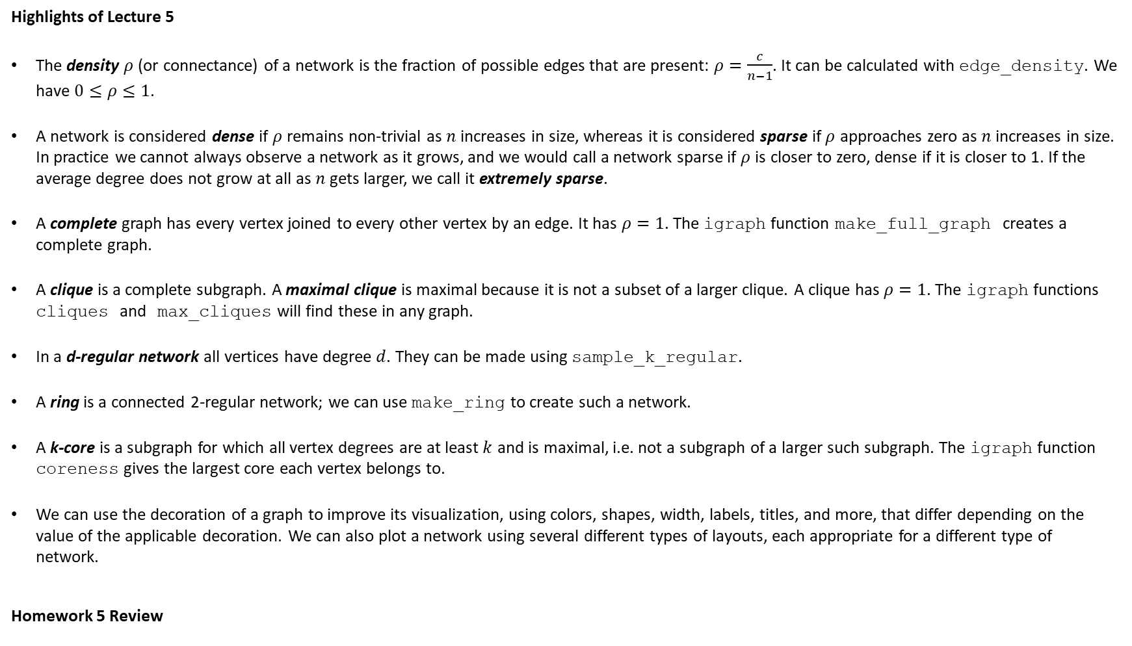
Review
Highlights of Lecture 5
The density $ρ$ (or connectance) of a network is the fraction of possible edges that are present: $ρ=\frac{c}{n−1}$. It can be calculated with edge_density. We have $0≤ρ≤1$.
A network is considered dense if $ρ$ remains non-trivial as $n$ increases in size, whereas it is considered sparse if $ρ$ approaches zero as $n$ increases in size. In practice we cannot always observe a network as it grows, and we would call a network sparse if $ρ$ is closer to zero, dense if it is closer to 1. If the average degree does not grow at all as $n$ gets larger, we call it extremely sparse.
A complete graph has every vertex joined to every other vertex by an edge. It has $ρ=1$. The igraph function make_full_graph creates a complete graph.
A clique is a complete subgraph. A maximal clique is maximal because it is not a subset of a larger clique. A clique has $ρ=1$. The igraph functions cliques and max_cliques will find these in any graph.
In a d-regular network all vertices have degree $d$. They can be made using sample_k_regular.
A ring is a connected 2-regular network; we can use make_ring to create such a network.
A k-core is a subgraph for which all vertex degrees are at least $k$ and is maximal, i.e. not a subgraph of a larger such subgraph. The igraph function coreness gives the largest core each vertex belongs to.
We can use the decoration of a graph to improve its visualization, using colors, shapes, width, labels, titles, and more, that differ depending on the value of the applicable decoration. We can also plot a network using several different types of layouts, each appropriate for a different type of network.
Homework 5 Review

Slide 4
Lazega Lawyers Network
The Lazega data set comes from a network study of corporate law partnership that was carried out in a Northeastern US corporate law firm, referred to as SG&R, 1988-1991 in New England. It includes (among others) measurements of networks among the 71 attorneys (partners and associates) of this firm, i.e. their strong-coworker network, advice network, friendship network, and indirect control networks. Various members' attributes are also part of the dataset, including seniority, formal status, office in which they work, gender, law school attended, individual performance measurements (hours worked, fees brought in), attitudes concerning various management policy options, etc.
Note that this is a subset of the originally collected data, consisting only of the 36 partners of the firm.
We have here an undirected network. It has the following vertex attributes: ‘name’, ‘Seniority’, ‘Status’ (all 1, meaning partner), ‘Gender’ (1 is man, 2 is woman), ‘Office’ (1 is Boston, 2 is Hartford, 3 is Providence), ‘Years’ (years with the firm), ‘Age’, ‘Practice’ (1 is litigation, 2 is corporate), and ‘School’ (1 is Harvard or Yale, 2 is University of Connecticut, 3 is other).
Provided to us by Emmanuel Lazega: E. Lazega, The Collegial Phenomenon: The Social Mechanisms of Cooperation Among Peers in a Corporate Law Partnership. Oxford University Press, Oxford (2001).

Slide 5
Lazega Lawyers Network Problem
Using only plot arguments (so do not change the graph itself), plot the Lazega graph as follows:
Create a set of three interesting colors, then let the vertices be colored depending on which of the three offices the lawyers work at.
Those lawyers that work in litigation (Practice=1) should have a circle vertex, those that work for corporate (Practice=2), a square vertex.
Make the vertex size proportional to the number of years the lawyer worked at the firm.
Create labels for the vertices equal to their seniority, so 1 indicates the most senior person in the network.
Let the label colors for the males be black and pick a different color for the females (one that is clearly visible).
Print the name of the graph at the top.
Offset small labels.
Print the description of the graph underneath its name.
Use your preferred layout.
Challenge: See if you can incorporate 1 or more legends.
Plot the original graph next to the final improved version.

Slide 6
Large Networks Visualization
When trying to visualize large networks, the picture can look cluttered and it may be difficult to glean any information from it.
If the vertices of a network fall into groups, we can coarsen the network by creating a meta-vertex for all vertices that fall into a level of the group using the igraph function contract, then aggregating the edges. Note that this will result in a multigraph, which we may then simplify to a simple weighted graph.
The fblog network is an undirected snapshot of French political blogs, extracted from a snapshot of over 1,100 such blogs on a single day in October of 2006 and classified by the “Observatoire Presidentielle” project as to political affiliation.
This network has 192 vertices and 1431 edges and is therefore too large to provide an uncluttered visualization. As such, we coarsen this network by political affiliation, simplify the graph, then visualize the result.

Slide 7
Large Networks Visualization Egocentric Networks
When dealing with large networks, we can also create an egocentric network. We choose a vertex we are most interested in and create an induced subgraph for that vertex and all its neighbors of a certain order.
An egocentric network of order one is an induced subgraph of a vertex with all its immediate neighbors; an egocentric network of order two is an induced subgraph of a vertex with all its neighbors and the immediate neighbors of those neighbors. An egocentric network of order k is an induced subgraph of a vertex and all vertices of maximum distance k to that vertex. We may use the igraph function make_ego_graph.
We can select which vertex we wish to use for our egocentric neighbor in any way we want. One way to choose a vertex would be to select the one with the highest degree, or, in a weighted network, the vertex with the greatest strength.

Slide 8
Problem
Set the vertex names of the aidsblog network to the vertex indices. Plot the network using the Fruchterman-Reingold layout.
Create an egocentric network around the vertex with the highest outgoing degree. Plot this network several times, each time using a different layout. Which one seems best in this case?
Show the frequency table for all outgoing and ingoing degrees of all vertices in this egocentric network, then plot its degree distributions. Describe the distribution of the degrees.
Which blogs link to the blog with the highest outgoing degree?

Slide 9
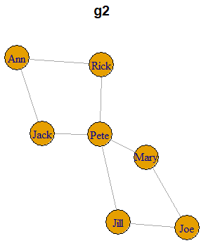
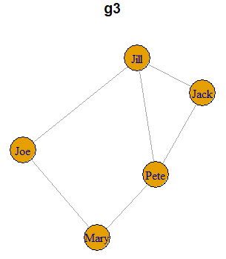
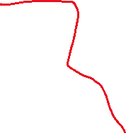
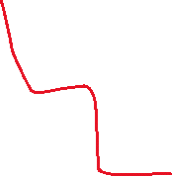
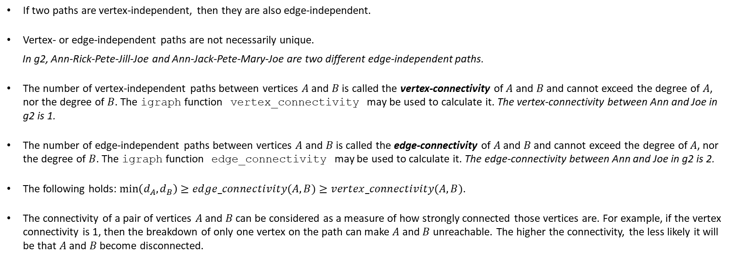
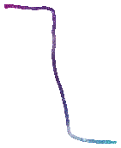

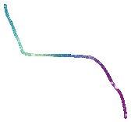
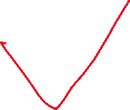
Independent Paths
Two paths connecting a given pair of vertices are edge-independent if they share no edges.
In g2, Ann-Rick-Pete-Mary-Joe and Ann-Jack-Pete-Jill-Joe are edge-independent paths.
Two paths connecting a given pair of vertices are vertex-independent if they share no vertices other than the start and end vertices.
In g2, Ann-Rick-Pete-Mary-Joe and Ann-Jack-Pete-Jill-Joe are NOT vertex-independent paths. In g3, Jack-Jill-Joe and Jack-Pete-Mary-Joe are vertex-independent paths. Can you find two vertex-independent paths between two different vertices in g2?
Pete-Mary-Joe and Pete-Jill-Joe
If two paths are vertex-independent, then they are also edge-independent.
Vertex- or edge-independent paths are not necessarily unique.
In g2, Ann-Rick-Pete-Jill-Joe and Ann-Jack-Pete-Mary-Joe are two different edge-independent paths.
The number of vertex-independent paths between vertices $A$ and $B$ is called the vertex-connectivity of $A$ and $B$ and cannot exceed the degree of $A$, nor the degree of $B$. The igraph function vertex_connectivity may be used to calculate it. The vertex-connectivity between Ann and Joe in g2 is 1.
The number of edge-independent paths between vertices $A$ and $B$ is called the edge-connectivity of $A$ and $B$ and cannot exceed the degree of $A$, nor the degree of $B$. The igraph function edge_connectivity may be used to calculate it. The edge-connectivity between Ann and Joe in g2 is 2.
The following holds: $\min\left(d_{A},d_{B}\right)≥edge_connectivity(A,B)≥vertex_connectivity(A,B)$.
The connectivity of a pair of vertices $A$ and $B$ can be considered as a measure of how strongly connected those vertices are. For example, if the vertex connectivity is 1, then the breakdown of only one vertex on the path can make $A$ and $B$ unreachable. The higher the connectivity, the less likely it will be that $A$ and $B$ become disconnected.

Slide 10
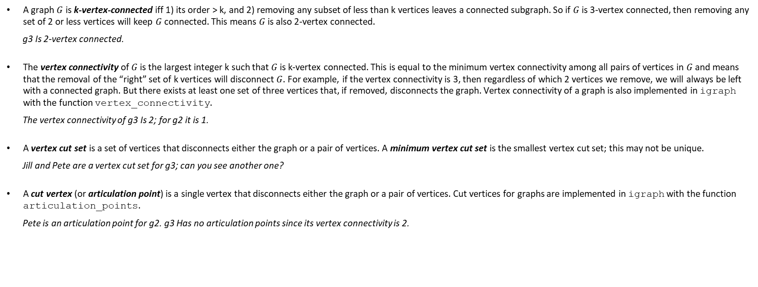
Cut Sets
A graph $G$ is k-vertex-connected iff 1) its order > k, and 2) removing any subset of less than k vertices leaves a connected subgraph. So if $G$ is 3-vertex connected, then removing any set of 2 or less vertices will keep $G$ connected. This means $G$ is also 2-vertex connected.
g3 Is 2-vertex connected.
The vertex connectivity of $G$ is the largest integer k such that $G$ is k-vertex connected. This is equal to the minimum vertex connectivity among all pairs of vertices in $G$and means that the removal of the “right” set of k vertices will disconnect $G$. For example, if the vertex connectivity is 3, then regardless of which 2 vertices we remove, we will always be left with a connected graph. But there exists at least one set of three vertices that, if removed, disconnects the graph. Vertex connectivity of a graph is also implemented in igraph with the function vertex_connectivity.
The vertex connectivity of g3 Is 2; for g2 it is 1.
A vertex cut set is a set of vertices that disconnects either the graph or a pair of vertices. A minimum vertex cut set is the smallest vertex cut set; this may not be unique.
Jill and Pete are a vertex cut set for g3; can you see another one?
A cut vertex (or articulation point) is a single vertex that disconnects either the graph or a pair of vertices. Cut vertices for graphs are implemented in igraph with the function articulation_points.
Pete is an articulation point for g2. g3 Has no articulation points since its vertex connectivity is 2.

Slide 11
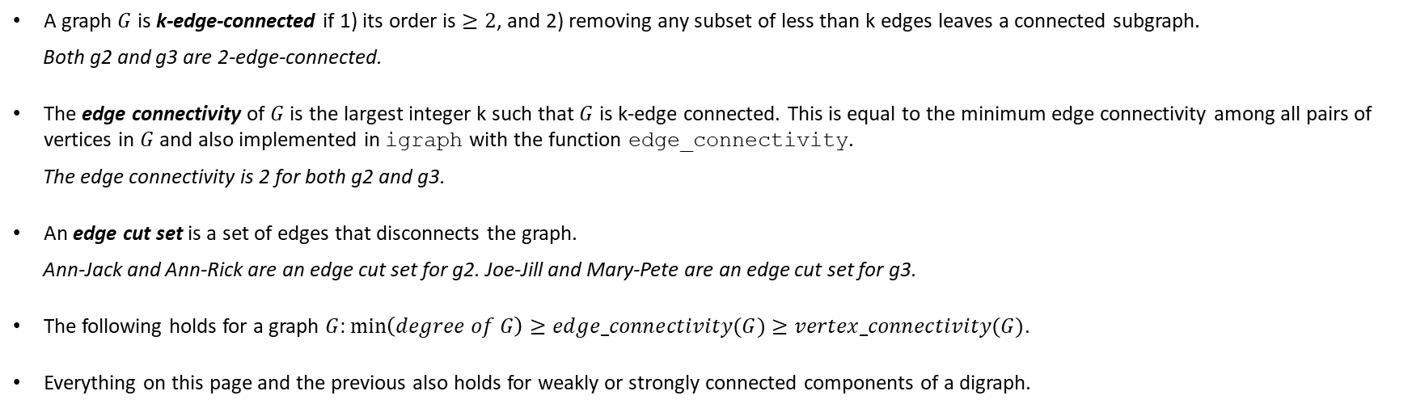
Cut Sets - 2
A graph $G$ is k-edge-connected if 1) its order is $≥2$, and 2) removing any subset of less than k edges leaves a connected subgraph.
Both g2 and g3 are 2-edge-connected.
The edge connectivity of $G$ is the largest integer k such that $G$ is k-edge connected. This is equal to the minimum edge connectivity among all pairs of vertices in $G$and also implemented in igraph with the function edge_connectivity.
The edge connectivity is 2 for both g2 and g3.
An edge cut set is a set of edges that disconnects the graph.
Ann-Jack and Ann-Rick are an edge cut set for g2. Joe-Jill and Mary-Pete are an edge cut set for g3.
The following holds for a graph $G$: $\min\left(degree of G\right)≥edge_connectivity(G)≥vertex_connectivity(G)$.
Everything on this page and the previous also holds for weakly or strongly connected components of a digraph.

Slide 12
Problem
Obtain the yeast network from the igraphdata package. Find out what it represents and how large it is (order and size).
Create a frequency table and a histogram of the degrees. What does this tell you?
Confirm that the network is not connected. Split it into components. How many components are there? There appears to be a giant component; how big is it? Save this giant network as giant. What percentage of the proteins does the giant contain?
Find the mean distance (use mean_distance) and the diameter of the giant. What do they mean in this context? Does these seem small to you compared to the order of the graph?
Find the vertex connectivity and the edge connectivity of the giant. Are there any cut vertices? If so, how many? What percentage is that of the total number of vertices (proteins) of the network? What does that mean?

Slide 13
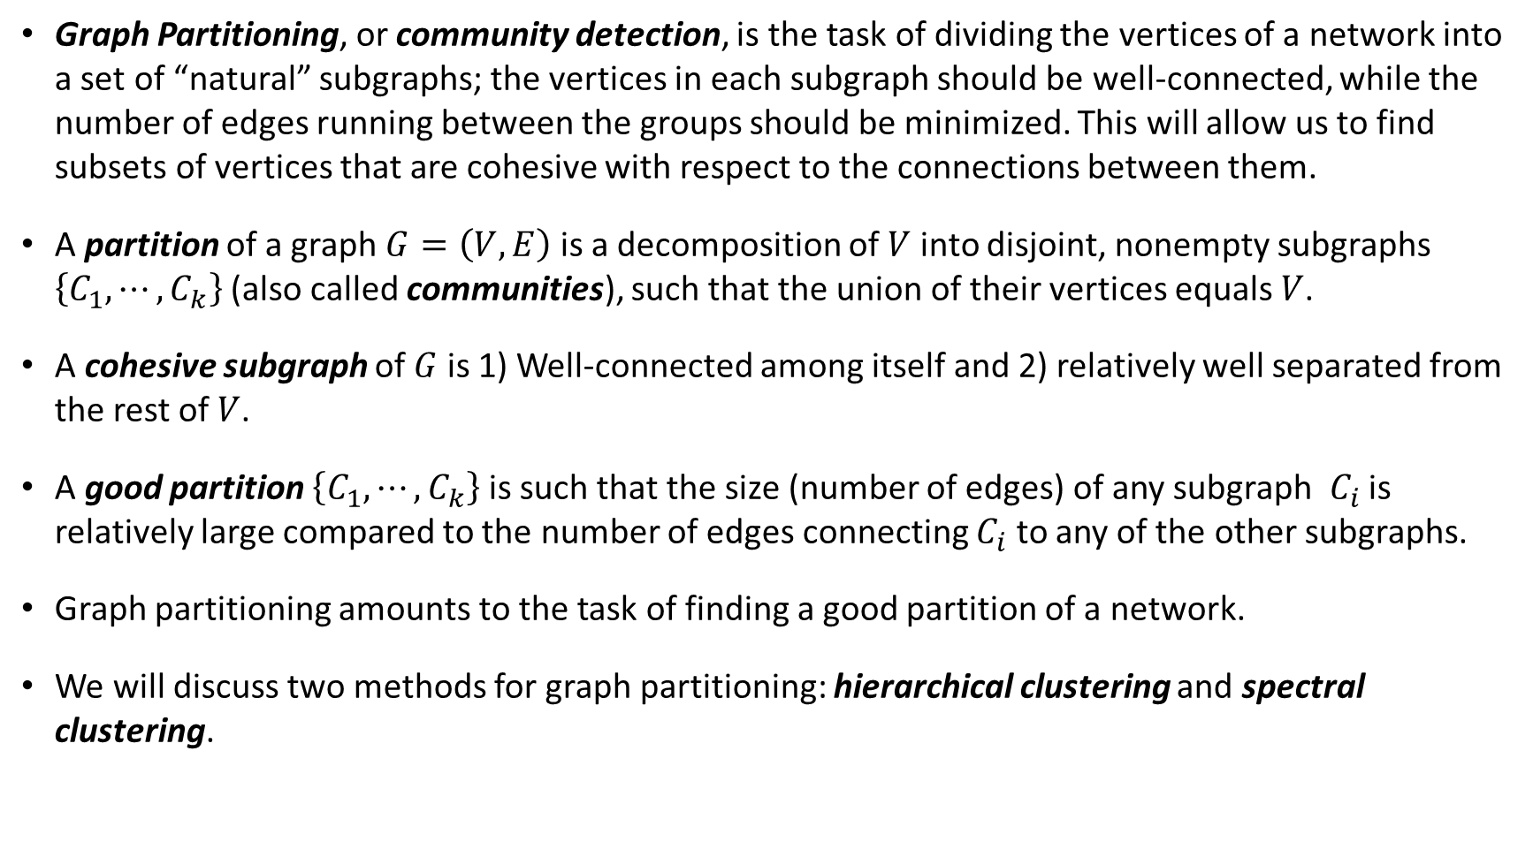
Graph Partitioning
Graph Partitioning, or community detection, is the task of dividing the vertices of a network into a set of “natural” subgraphs; the vertices in each subgraph should be well-connected, while the number of edges running between the groups should be minimized. This will allow us to find subsets of vertices that are cohesive with respect to the connections between them.
A partition of a graph $G=\left(V,E\right)$ is a decomposition of $V$ into disjoint, nonempty subgraphs $\left\{C_{1},⋯,C_{k}\right\}$(also called communities), such that the union of their vertices equals $V$.
A cohesive subgraph of $G$ is 1) Well-connected among itself and 2) relatively well separated from the rest of $V$.
A good partition $\left\{C_{1},⋯,C_{k}\right\}$ is such that the size (number of edges) of any subgraph $C_{i}$ is relatively large compared to the number of edges connecting $C_{i}$ to any of the other subgraphs.
Graph partitioning amounts to the task of finding a good partition of a network.
We will discuss two methods for graph partitioning: hierarchical clustering and spectral clustering.

Slide 14
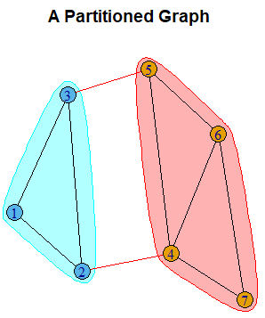
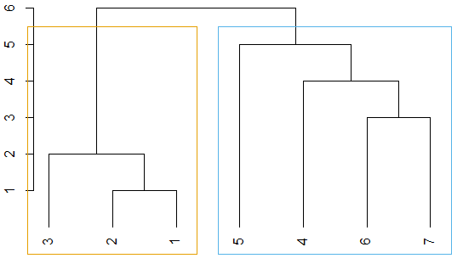
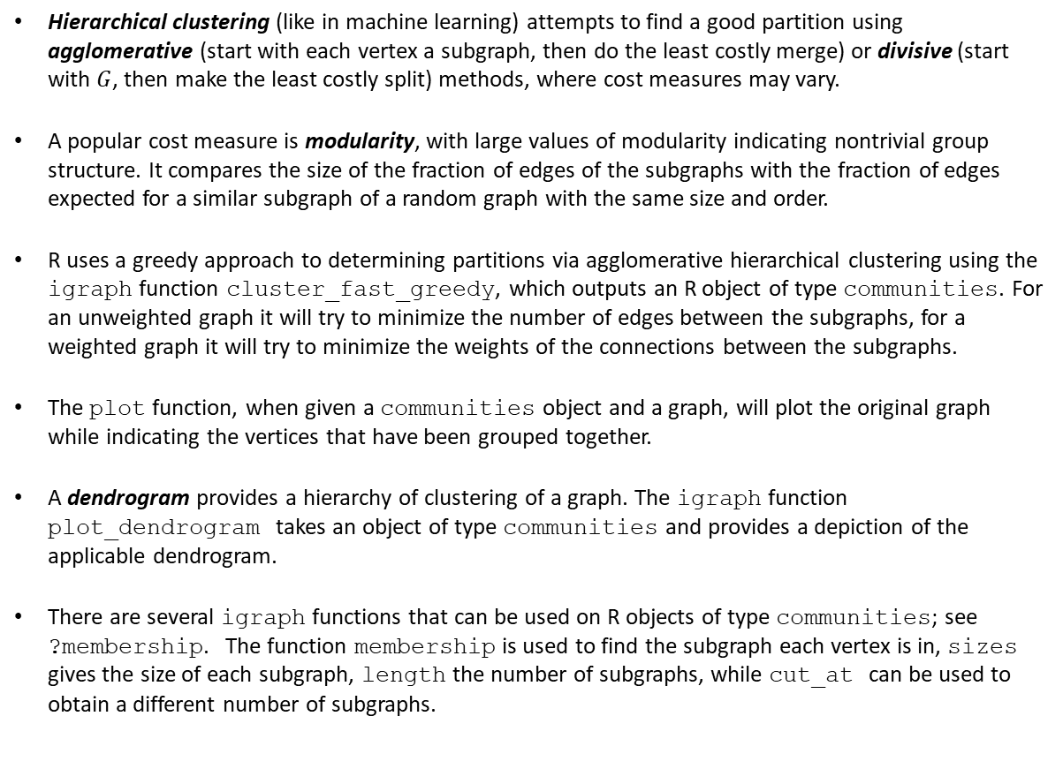
Graph Partitioning Hierarchical Clustering
Hierarchical clustering (like in machine learning) attempts to find a good partition using agglomerative (start with each vertex a subgraph, then do the least costly merge) or divisive (start with $G$, then make the least costly split) methods, where cost measures may vary.
A popular cost measure is modularity, with large values of modularity indicating nontrivial group structure. It compares the size of the fraction of edges of the subgraphs with the fraction of edges expected for a similar subgraph of a random graph with the same size and order.
R uses a greedy approach to determining partitions via agglomerative hierarchical clustering using the igraph function cluster_fast_greedy, which outputs an R object of type communities. For an unweighted graph it will try to minimize the number of edges between the subgraphs, for a weighted graph it will try to minimize the weights of the connections between the subgraphs.
The plot function, when given a communities object and a graph, will plot the original graph while indicating the vertices that have been grouped together.
A dendrogram provides a hierarchy of clustering of a graph. The igraph function plot_dendrogram takes an object of type communities and provides a depiction of the applicable dendrogram.
There are several igraph functions that can be used on R objects of type communities; see ?membership. The function membership is used to find the subgraph each vertex is in, sizes gives the size of each subgraph, length the number of subgraphs, while cut_at can be used to obtain a different number of subgraphs.

Slide 15
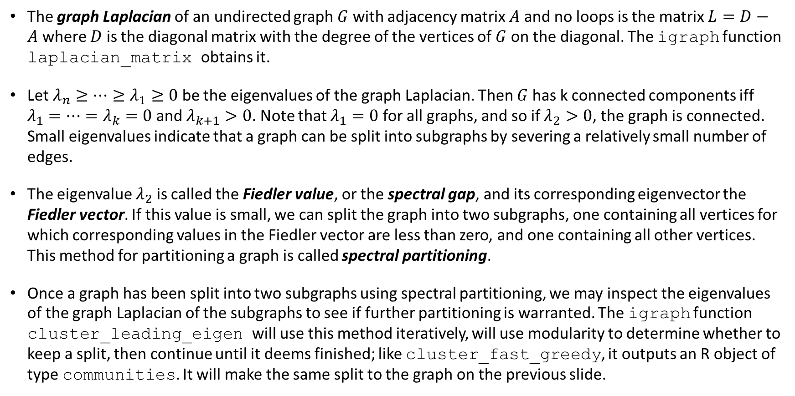
Graph Partitioning Spectral Partitioning
The graph Laplacian of an undirected graph $G$ with adjacency matrix $A$ and no loops is the matrix $L=D−A$ where $D$ is the diagonal matrix with the degree of the vertices of $G$ on the diagonal. The igraph function laplacian_matrix obtains it.
Let $λ_{n}≥⋯≥λ_{1}≥0$ be the eigenvalues of the graph Laplacian. Then $G$ has k connected components iff $λ_{1}=⋯=λ_{k}=0$ and $λ_{k+1}>0$. Note that $λ_{1}=0$ for all graphs, and so if $λ_{2}>0$, the graph is connected. Small eigenvalues indicate that a graph can be split into subgraphs by severing a relatively small number of edges.
The eigenvalue $λ_{2}$ is called the Fiedler value, or the spectral gap, and its corresponding eigenvector the Fiedler vector. If this value is small, we can split the graph into two subgraphs, one containing all vertices for which corresponding values in the Fiedler vector are less than zero, and one containing all other vertices. This method for partitioning a graph is called spectral partitioning.
Once a graph has been split into two subgraphs using spectral partitioning, we may inspect the eigenvalues of the graph Laplacian of the subgraphs to see if further partitioning is warranted. The igraph function cluster_leading_eigen will use this method iteratively, will use modularity to determine whether to keep a split, then continue until it deems finished; like cluster_fast_greedy, it outputs an R object of type communities. It will make the same split to the graph on the previous slide.

Slide 16
Problem
Show the summary for the giant component of the yeast network. There appears to be a vertex attribute called Class. Show a frequency table for this attribute.
Use hierarchical partitioning to partition the giant. How many partitions are there?
Create a contingency table between membership in a subgraph according to the hierarchical partition, and the vertex attribute Class. Can you say something interesting about this table?
Use spectral partitioning to partition the giant. How many partitions are there now?
Create a contingency table between membership in a subgraph according to the spectral partition, and the vertex attribute Class. Can you say something interesting about this table?

Slide 17

Today’s Summary
We can improve the visualization of a large network if the vertices are split into groups. We may then coarsen the network using the igraph function contract. Alternatively, we can create an egocentric network; we choose a vertex we are most interested in and create an induced subgraph for that vertex and all its neighbors of a certain order. We may use the igraph function make_ego_graph for this.
Two paths connecting a given pair of vertices are edge-independent if they share no edges. They are vertex-independent if they share no vertices other than the start and end vertices. If two paths are vertex-independent, then they are also edge-independent. Vertex- or edge-independent paths are not necessarily unique.
The number of vertex-independent paths between vertices $A$ and $B$ is called the vertex-connectivity of $A$ and $B$. Use vertex_connectivity. Vertex connectivity can be considered as a measure of how strongly connected the vertices in question are.
The number of edge-independent paths between vertices $A$ and $B$ is called the edge-connectivity of $A$ and $B$. Use edge_connectivity.
A graph $G$ is k-vertex-connected iff 1) its order > k, and 2) removing any subset of less than k vertices leaves a connected subgraph. The vertex connectivity of $G$ is the largest integer k such that $G$ is k-vertex connected. Use vertex_connectivity.
A vertex cut set is a set of vertices that disconnects either the graph or a pair of vertices. A minimum vertex cut set is the smallest vertex cut set; this may not be unique. A cut vertex (or articulation point) is a single vertex that disconnects either the graph or a pair of vertices. Use articulation_points.
A graph $G$ is k-edge-connected if 1) its order is $≥2$, and 2) removing any subset of less than k edges leaves a connected subgraph. The edge connectivity of $G$ is the largest integer k such that $G$ is k-edge connected. Use edge_connectivity.
An edge cut set is a set of edges that disconnects the graph.
$\min\left(d_{A},d_{B}\right)≥edge_connectivity(A,B)≥vertex_connectivity(A,B)$ and $\min\left(degree of G\right)≥edge_connectivity(G)≥vertex_connectivity(G)$.
A partition of a graph $G=\left(V,E\right)$ is a decomposition of $V$ into disjoint, nonempty subgraphs $\left\{C_{1},⋯,C_{k}\right\}$(also called communities) such that the union of their vertices equals $V$.
A cohesive subgraph of $G$ is 1) Well-connected among itself and 2) relatively well separated from the rest of $V$.
A good partition $\left\{C_{1},⋯,C_{k}\right\}$ is such that the size (number of edges) of any subgraph $C_{i}$ is relatively large compared to the number of edges connecting $C_{i}$ to any of the other subgraphs. Graph Partitioning, or community detection, amounts to the task of finding a good partition of a network.
The graph Laplacian of an undirected graph $G$ with adjacency matrix $A$ and no loops is the matrix $L=D−A$ where $D$ is the diagonal matrix with the degree of the vertices of $G$ on the diagonal. The igraph function laplacian_matrix obtains it. Let $λ_{n}≥⋯≥λ_{1}≥0$ be the eigenvalues of the graph Laplacian. Then $G$ has k connected components iff $λ_{1}=⋯=λ_{k}=0$ and $λ_{k+1}>0$. Note that $λ_{1}=0$ for all graphs, and so if $λ_{2}>0$, the graph is connected. Small eigenvalues indicate that a graph can be split into subgraphs by severing a relatively small number of edges. The eigenvalue $λ_{2}$ is called the Fiedler value, or the spectral gap, and its corresponding eigenvector the Fiedler vector. If this value is small, we can split the graph into two subgraphs, one containing all vertices for which corresponding values in the Fiedler vector are less than zero, and one containing all other vertices. This method for partitioning a graph is called spectral partitioning. Use cluster_leading_eigen to use this method iteratively. it outputs an R object of type communities.
Hierarchical clustering can be performed in R using cluster_fast_greedy, which outputs an R object of type communities. For an unweighted graph it will try to minimize the number of edges between the subgraphs, for a weighted graph it will try to minimize the weights of the connections between the subgraphs. A dendrogram provides a hierarchy of clustering of a graph. Use plot_dendrogram to see the applicable dendrogram. Use cut_at to obtain a different number of partitions.
The plot function, when given a communities object and a graph, will plot the original graph while indicating the vertices that have been grouped together.
There are several igraph functions that can be used on R objects of type communities; see ?membership.

